Slide 1
Ancient Greece Frontloading
Getting the Skinny

Slide 2
http://www.bbc.co.uk/schools/primaryhistory/ancient_greeks/
Open a word document
Put in a header – First/Last Name, Ms. Benson, GT Period 3, 1/10/14
Save it as First/Last Name Frontloading Greece
Open this address using Chrome

Slide 3
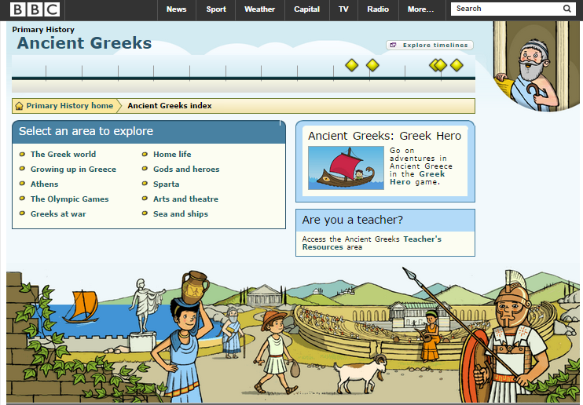
Frontloading Greece
Resource
BBC Website Primary History-Ancient Greeks
Instructions
Review ALL the readings for each area
Take the Quiz for each area and record your results in a word document.
Example: The Greek World – Quiz Score
Do the readings in order down the first column and then down the second.
All done? Put a header on your word document and save with File name
First/Last name Frontloading Greece
Now you are free to play the interactive games and look at pictures and links for more information.

Slide 4
Choose one of the two projects A Trip to Olympia or Living in Athens
Create a word document with a header.
Write a travel diary for A trip to Olympia
or
describe a day in your life for Living in Athens
Assignment is at least one page single spaced 12 font. It can include one picture. It should be detailed and imaginative.
Include URL addresses of resources.
File Name: First/Last Name Trip to Olympia
File Name: First/Last Name Living in Athens

Slide 5
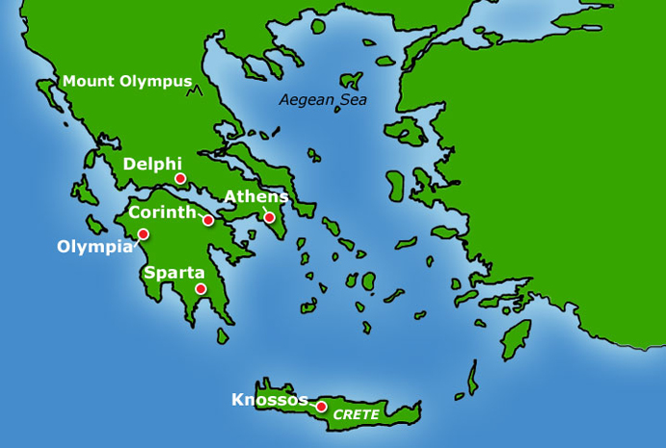
All done?
Save your test scores document to TeacherInBox with file name First/Last Name Greece Test Scores
Save your Trip to Olympia or your Living in Athens to my TeacherInBox with file name
First/Last Name Trip to Olympia
First/Last Name Living in Athens
Go to the TeacherOutBox and open the file called Ancient Greece Interactive Sites. You can do any of the sites listed here or any other site you can find relating to ancient Greece.

