Slide 1
Democracy Develops in Ancient Greece
HA 1.4
You will be able to …
Distinguish from among four forms of government—monarchy, oligarchy, tyranny, and democracy
Explain the etymologies of monarchy, oligarchy, tyranny and democracy
Describe how democracy emerged in Greece during the late 500s BCE

Slide 2
Standards
GEH 4.5.1- Identify the major forms of government in the Eastern Hemisphere and compare them with the United States. AND WHC 4.4.2- Analyze the various political influences which shaped western civilization including the City-State, Monarchy, Republic, Nation-State, and Democracy. | Declarative Knowledge: Understand the attributes of different government systems. Identify the forms of government that developed in the ancient Greek city-states (e.g., monarchy, oligarchy, democracy, tyrants, and anarchy) | Procedural Knowledge: - Compare Greek democracy to the United State’s democracy (e.g., elections, representation, and citizens)

Slide 3
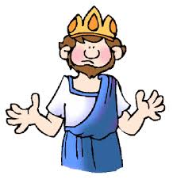
Scenario I think we should listen to music today in class. What station should we listen to? What volume should the radio be tuned to?
In this activity you will use the principles of four forms of government from ancient Greece to select a station and set the volume.
We will start with monarchy
King
Prince
Notes:
King sits on the desk
Prince sits in the chair behind the second desk

Slide 4
Simulation 1a Monarchy
Your majesty, please select a station that your and your prince like and set the volume. Remember other classes shouldn’t be disturbed. Do it quickly.
Read your class reading on monarchy while the radio plays.
Notes:
Punish any students who object by having them sit on the floor at the back of the class.
Monarchs can use military power (that’s me today) to control those who challenge their authority.

Slide 5
Simulation 1b Monarchy
Our monarch has died. Our prince has become the ruling monarch.
Monarchies are hereditary.
Let us bury our monarch in his tomb at the back of the room.
Prince, please select a station that your like and set the volume. Remember other classes shouldn’t be disturbed. Do it quickly.
Notes:
Monarch lie down at the back of the room in your grave.
Prince move to the desk and program the radio. Play the radio loud enough that only prince can hear it.
This is designed to show that a monarch’s successor may be self-indulgent and choose to ignore the needs of his subjects.
When directed by prince teacher will punish students who raise objections by having them sit on the floor at the back of the classroom.
Prince may play radio for 1 – 2 minutes.
While prince is listening encourage students who are frustrated by prince’s actions to get on one knee and respectfully express their discontent. This is to show that in a monarchy, subjects must exercise caution when questioning the acts of the monarch.

Slide 6
Subjects, how did you feel during this activity?
King/prince how did you feel?
Who makes the decisions in a monarchy?
What are the advantages of a monarchy? …disadvantages?
Why do you think monarchy was one of the first forms of government to develop in ancient Greece?
Why did it decline?

Slide 7
Scenario Oligarchy
Since some of you were dissatisfied with monarchy you will be allowed to use the principles of oligarchy to program our radio.
In an oligarchy a few individuals—aristocrats and/or selected wealthy members of the middle class—have the power. They make all of the political decisions.
Aristocrats in ancient Greece were the wealthy land owners. Aristocracy is hereditary—passed from father to son, etc.
The middle class were wealthy and talented citizens who wanted to become oligarchs but had no power, so they often vied for power with the aristocrats.
Pull 3 desks to the front for the aristocrats
Pull 5 desks to the side for middle class.
The rest of you are lower class
Notes:
3 students with most family musicians are aristocrats.
5 students who take music lessons are middle class

Slide 8
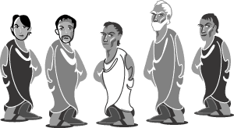
Simulation 2a Oligarchy
These 3 aristocrats--citizens who become oligarchs by birth--now have the power to program the radio.
Those who inherit political power because of family lineage are often the first to assume power in an oligarchy.
Read your class reading on oligarchy while the radio plays.
Notes:
Have 3 students who have the most musicians in their family sit at 3 desks reserved for aristocrats
Have 5 students who take music lessons sit at the 5 desks representing the middle class.
The rest of the class are ordinary.
Aristocrats, you can program the radio with or without input from the rest of the class. You can punish those who voice objections.
Middle class offer suggestions to aristocrats—you may shout (not too loud) your suggestions aloud.
Aristocrats you must ignore the middle class.
Middle class you need to complain loudly about the fact that you don’t get to influence the decision on how to program the radio
Aristocrats—punish ORDINARY citizens who raise objections – have them sit on the floor at the back of the classroom
Aristocrats program the radio based on what you have decided. Have on aristocrat dissent. Have that person sit with the ordinary resto of the class and pick one member of the middle class to become an aristocrat.
Now program the radio

Slide 9
Ordinary citizens, how did you feel in this part of the activity?
Aristocrats and members of the middle class, how did you feel?
How did you feel when a member of the middle class was allowed to help the aristocrats program the radio?
Who makes the decisions in an oligarchy?
What are the advantages of an oligarchy? …disadvantages?
Why do you think oligarchies developed after monarchies in ancient Greece?
Why did oligarchies decline in ancient Greece?

Slide 10
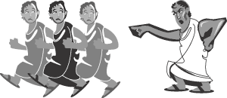
Scenario Tyranny
Discontent with the aristocratic leaders of oligarchies in ancient Greece led to the rise of new leaders called tyrants.
The Greek used the work tyranny differently than we do today. To them it meant one person who rules well by force and single-handedly.
Notes:
Select most forceful outspoken person in class to be tyrant—to show that they were often former military leaders who responded to the demands of the middle class.
Aristocracy and middle class go back to their seats.
Select the tyrant before class and coach him/her on the behaviors they need to show.

Slide 11
Simulation 3a Tyranny
Our new Tyrant will now program the radio.
All persons who have black hair may give the tyrant input on what radio station he/she might play.
Tyrants got power by making political promises to certain segments of society.
If you gave input you must also give the tyrant a token (a pen or a pencil.)
Tyrants got wealthier as they gained more political power.
Read your class reading on tyranny while the radio is playing
Notes:
Tyrant—seek input from all students with blue jeans or some other thing before you program the radio– This shows how tyrants got power by making political promises to a certain segment of society (people.)
Students who give input should bring the tyrant simple gifts, like pens/pencils, etc. Tyrants became wealthier as a result of gaining political power.
Encourage students to complain loudly about the gifts the tyrant is getting. Once it gets loud enough have the tyrant turn off the radio and run back to his/her seat.

Slide 12
Ordinary citizens, members of the middle class, and aristocrats, how did you feel in this part of the activity?
Tyrant, how did you feel?
Who makes the decisions in a tyranny?
What are the advantages of a tyranny? …disadvantages?
Why do you think tyrannies developed after oligarchies in ancient Greece?
Why did tyrannies decline in ancient Greece?

Slide 13
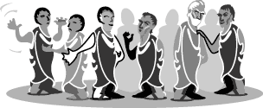
Scenario Democracy
Since you were dissatisfied with the actions of our tyrant, we will now use the principles of a fourth type of government to program our radio.
Democracy developed around 510 BCE in Athens after a harsh tyrant was overthrown.
Athenian citizens chose to share political power among themselves.
In a democracy, political decisions are made by majority vote.

Slide 14
Simulation 4a Democracy
You will now vote on how to program the radio.
The decision will be based on the wishes of the majority.
The station chosen and the volume must be acceptable to more than half the students in our class.
You have 2 minutes to make your decision.
You may quietly voice your opinions
Have a few of you maintain order so that everyone’s voice can be heard and votes can be counted quickly.
Once the majority of you have agreed on the station you may program the radio.
Read your class reading on tyranny while the radio is playing

Slide 15
How did you feel in this part of our simulation?
Who makes the decisions in a democracy?
What are the advantages of a democracy? …disadvantages?
Why do you think democracy developed in ancient Greece?

Slide 16
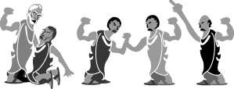
Anarchy
Sometimes, after one ruler or group had been overthrown, no-one at all ruled for a while. This was called anarchy, from the Greek word anarkhos, meaning ‘without a ruler’.

Slide 17
Assessment
Use what you’ve learned in the simulation to fill in student handout 1.4B.
Write your name and period on both sides
Write ISN Page 31 on both sides.
When finished tape the worksheet loosely on page 31.
BE SURE YOU CAN SEE YOUR HANDWRITTEN NOTES ON PAGE 31 TOO.

Slide 18
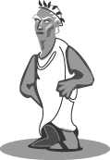
Monarchy
At first, most city-states were ruled by kings. This type of government is called a monarchy from the Greek words mono meaning ‘one’ and arkho meaning ‘rule’. The king often ruled with the help of a council of nobles or rich landowners called the aristocracy. On the death of a king, his eldest son took his place. This is called ‘hereditary rule’, which means that power is passed on through the one family.

Slide 19
Aristocracy
By 800 BC many city-states were ruled by rich landowners. This type of government is called an aristocracy, from the Greek words aristos, meaning ‘the best people’ and kratos meaning ‘power’. In an aristocracy, power is inherited or passed down from parents to their children.

Slide 20
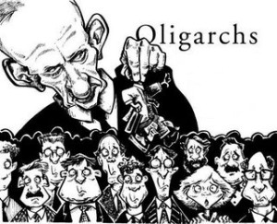
Oligarchy
Where a small group ruled, government was called an oligarchy, from the word oligos, meaning ‘the few’. Such a powerful small group might arise from the aristocracy, the wealthy, businesses, the military, strong individuals or those experienced in government.

Slide 21
Tyranny (Dictatorship)
Sometimes a strong individual seized power and ruled alone. This was called a tyranny, from the Greek word turannos, meaning ‘cruel ruler’. This is a word still used today, but the more common word now for a ruler who seizes power and rules alone is a dictator, and the form of government is called a dictatorship.

Slide 22
Democracy
The biggest city-state, Athens, experienced all these types of government at different times, but the ordinary citizens of Athens gradually got more and more say in how they were governed until, by around 500 BC, it became a democracy, from the Greek words demos, meaning ‘the people’ and kratos meaning ‘power’.

