Slide 1
Crete and Mycenae
Identifying the Roots of Greek Civilization
HA 1.2

Slide 2
In this activity you will be able to…
Identify and analyze six Minoan and six Mycenaean artifacts
Match Minoan and Mycenaean artifacts and identify similarities and differences among them
Describe how the Minoan civilization of Crete influenced the cultures of mainland Greece during the Bronze Age
WHC 2.3.4- Explain how transportation routes stimulate growth of cities and the exchange of goods, knowledge, and technology.
WHST.6-8.9 Draw evidence from informational texts to support analysis reflection, and research.

Slide 3
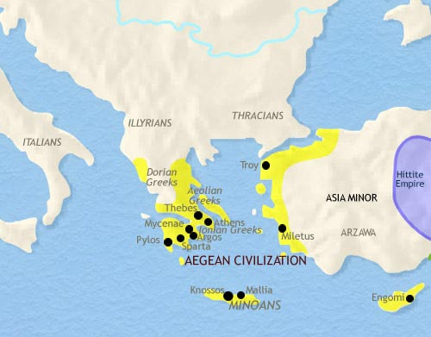
Peloponnesian Peninsula

Slide 4
5 Elements of Civilization
Organized Religion
Centralized Government
Arts, Architecture, and Public Works
Job Specialization & Social Classes
Writing

Slide 5
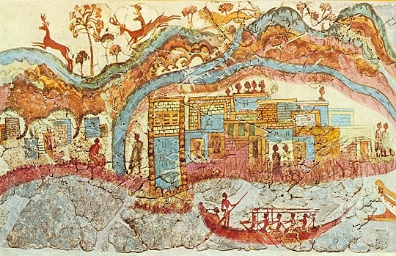
Minoan Culture
Birthplace of Zeus
Island ½ way between Greece and Asia Minor (modern day Turkey)
Developed 3000BCE
Maritime culture – fishing, farming, local arts
Trade routes with Spain, Egypt, Canaan, and Asia Minor
Egalitarian (equal) men & women held respected positions
Known for sport “bull leaping” and boxing
Peace loving-lacked fortresses, war equipment, painted battle scenes
Cultural model for Mycenaean civilization

Slide 6
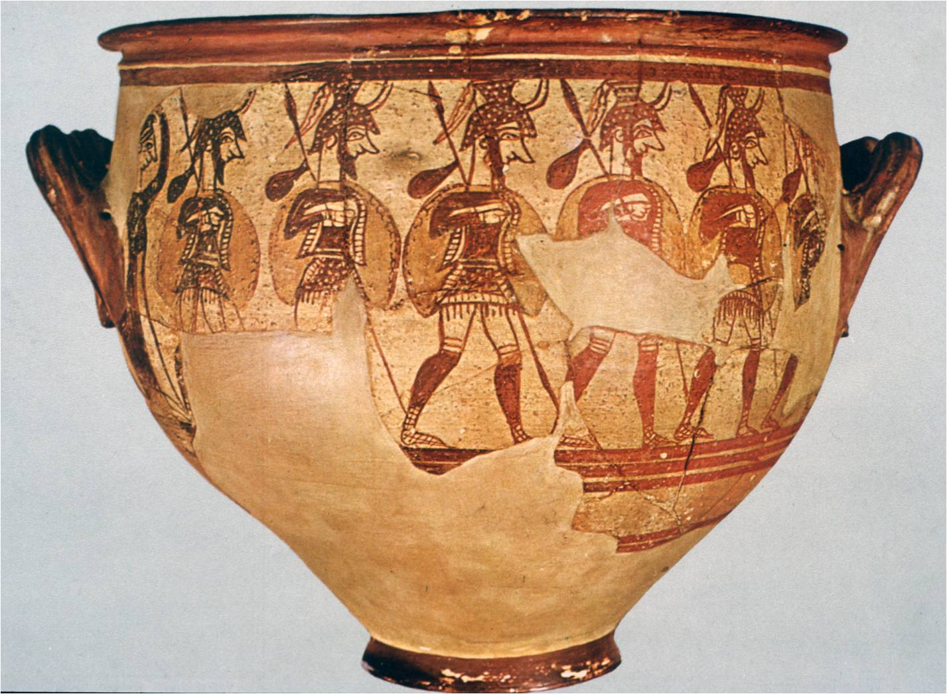
Mycenaean Culture
Settled in 2700 BCE
Most Greek myths come from Mycenae
Spoke early form of Greek language
Farming economy based on grains, grapes, & olives
Traded by sea
Had strong military and were warlike
Buried royalty in circular tombs where many military artifacts were found
Valued horses
Society was “hierarchical”-soldiers in positions of power –slaves at the bottom
Little or no evidence of recreational pastimes found

Slide 7
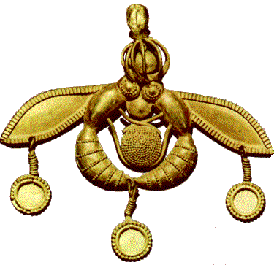

Slide 8
Metalwork
According to legend, the ancient architect Daedalus, who built part of the Minoan Palace of Knossos, once crafted a perfect honeycomb out of gold. He presented it to the Goddess Aphrodite as an offering, and it delighted her. Metalworkers at the palace on Crete were as talented as Daedalus and used a variety of metals. The tools they created for farmers, carpenters, gem-cutters, and shipbuilders were made of bronze, a mixture of copper and tin. They also fashioned fish-hooks made of copper for fishing poles. Their most beautiful delicate and beautiful work was done with gold. Minoan metalworkers made golden seals for documents and golden jewelry for the Minoan nobles. The gold pendant pictured here was made to be worn on a necklace chain, or as a decoration in a Minoan noblewoman’s hair. It depicts two bees holding a honeycomb between them and sharing a drop of its honey. It was said that honey was often used in offerings to the Gods at Knossos, in honor of Aphrodite and Daedalus.

Slide 9
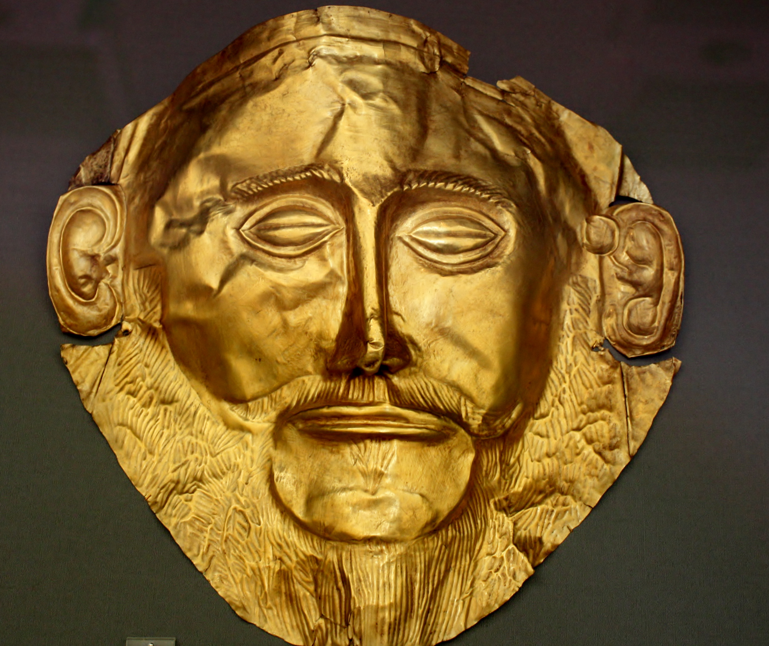

Slide 10
Metalwork
The Mycenaean's valued military strength and fine weapons for warfare. Many of these weapons were made of bronze, a mixture of copper and tin. Craftspeople who worked in bronze, or bronzesmiths, created splendid bronze daggers, swords, shields, and helmets for the Mycenaean army. Bronzesmiths also made chest, arm, and leg guards (called chain mail) for soldiers, and bronze fittings for their horses. Kings and high-ranking soldiers had bronze wheels made for their chariots, instead of the usual wooden ones. In addition to military equipment, bronzesmiths made small cooking pots and larger pots, called cauldrons. Mycenaean craftspeople also worked with gold. Goldsmiths fashioned gold into exquisite rings, earrings, necklaces, seals for documents, cups, bowls, and artwork. Gold objects were made only for kings and nobles, and were buried with them when they died. The object shown here is a gold funeral mask, which was placed over the face of a dead king or noble at his burial.

Slide 11
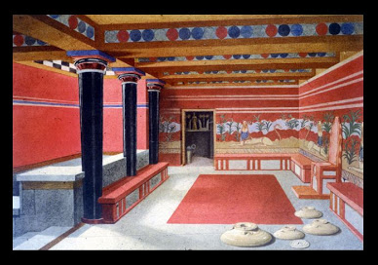

Slide 13
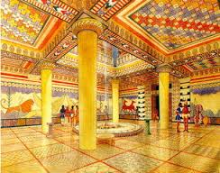

Slide 15
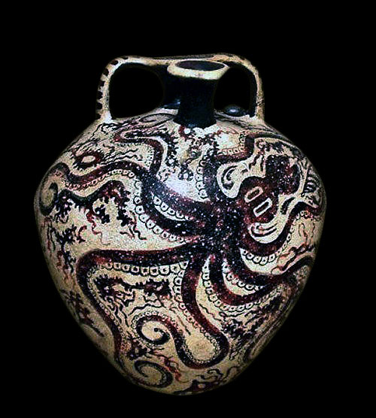
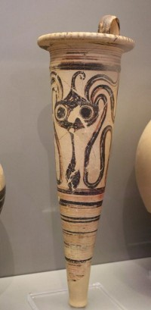

Slide 16
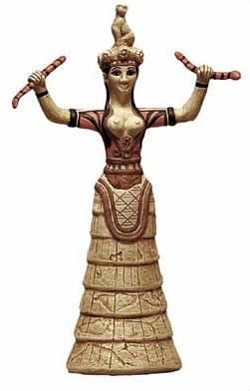
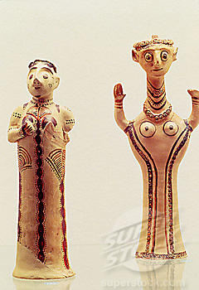

Slide 17
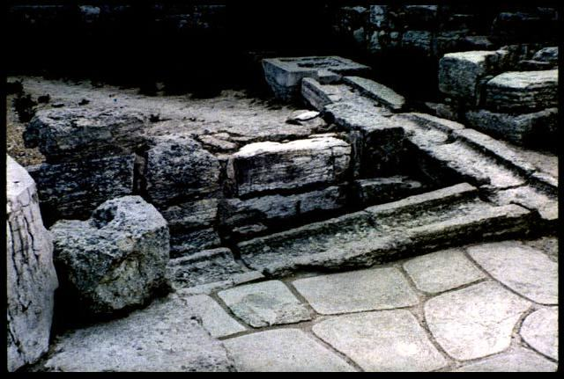
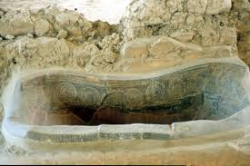

Slide 18
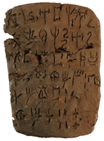
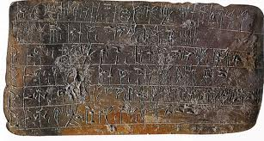

Slide 19
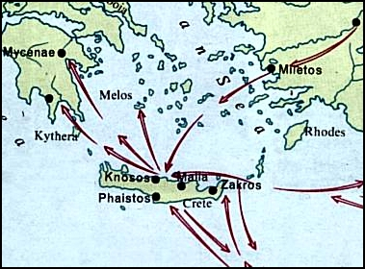
What did the Minoan and Mycenaean civilizations have in common?
In what ways were they different?
Why do you think that so many aspects of Minoan civilization were found at Mycenae?
What other geographical areas besides Mycenae, might Minoan civilization have influenced?
What aspects of Minoan and Mycenaean civilizations would you expect to have survived in later periods of Greek history?
(aspect - a particular part or feature of something)

Slide 20
Endings
Minoan
2000BCE to 1400BCE – 600 years
Severe earthquakes and tsunamis in 1700BCE almost wiped out all villages
Rebuilt cities and reestablished trade in these places
  Thera, Kythera, Melos, Rhodes
Benefited from trade with other areas and were tolerant of others
Mycenaeans invaded from Greek mainland in 1450BCE ending peaceful Minoan civilization
Captive Minoan architects and artist were sent to Mycenae to serve
Mycenaean rulers occupied palace at Knossos
Mycenaeans introduced weapons, chariots, and battles into Cretan mural painting and buried weapons alongside military dead
Mycenaean
In 1450BCE Mycenaeans began invading Crete
They may have been trying to replenish supplies of copper and ores
They also left because of conflicts over land-ownership and trade routes left Mycenae in a weakened state
They couldn’t hold off encroaching cultures on mainland Greece and sought safer settlements on Crete
Linear B documents from Mycenae record an invasion.
300 years later in 1100BCE Dorian Greeks-- united tribes from NW Greece and Asia Minor– invaded Mycenaean settlements in the Peloponnesus, southern Aegean islands, and Crete and ended Mycenaean rule
Through the Dorians, elements of Minoan and Mycenaean cultures were incorporated into the art, architecture, and literature of Classical Greece.

